Slide 1
Vivek Shrivastava
Parallel Processing

Slide 2
Multiple Processor Organization
Single instruction, single data stream - SISD
Single instruction, multiple data stream - SIMD
Multiple instruction, single data stream - MISD
Multiple instruction, multiple data stream- MIMD

Slide 3
Single Instruction, Single Data Stream - SISD
Single processor
Single instruction stream
Data stored in single memory
Uni-processor

Slide 4
Single Instruction, Multiple Data Stream - SIMD
Single machine instruction
Controls simultaneous execution
Number of processing elements
Lockstep basis
Each processing element has associated data memory
Each instruction executed on different set of data by different processors
Vector and array processors

Slide 5
Multiple Instruction, Single Data Stream - MISD
Sequence of data
Transmitted to set of processors
Each processor executes different instruction sequence
Never been implemented

Slide 6
Multiple Instruction, Multiple Data Stream- MIMD
Set of processors
Simultaneously execute different instruction sequences
Different sets of data
SMPs, clusters and NUMA systems

Slide 7
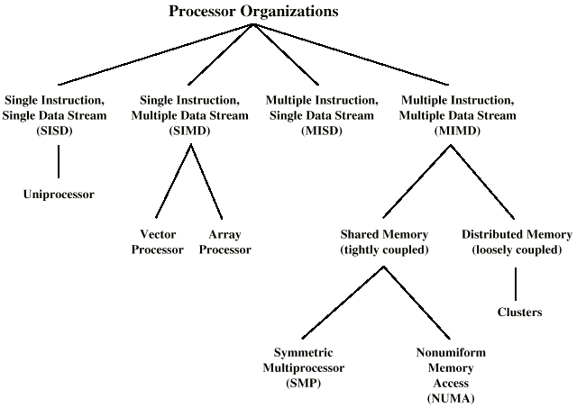
Taxonomy of Parallel Processor Architectures

Slide 8
MIMD - Overview
General purpose processors
Each can process all instructions necessary
Further classified by method of processor communication

Slide 9
Tightly Coupled - SMP
Processors share memory
Communicate via that shared memory
Symmetric Multiprocessor (SMP)
Share single memory or pool
Shared bus to access memory
Memory access time to given area of memory is approximately the same for each processor

Slide 10
Tightly Coupled - NUMA
Nonuniform memory access
Access times to different regions of memory may differ

Slide 11
Loosely Coupled - Clusters
Collection of independent uniprocessors or SMPs
Interconnected to form a cluster
Communication via fixed path or network connections

Slide 12
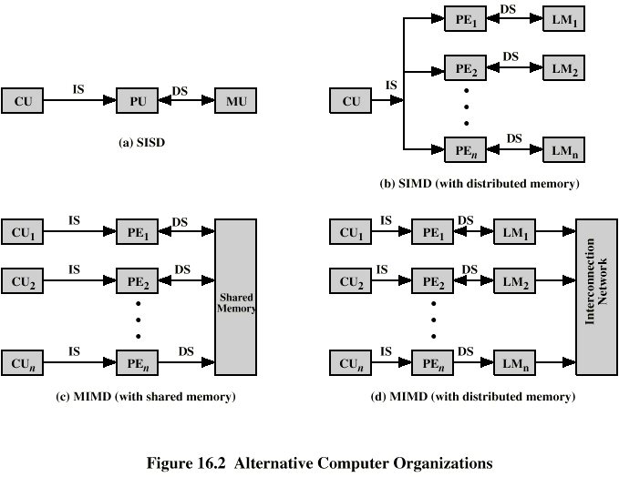
Parallel Organizations - SISD

Slide 13
Parallel Organizations - SIMD

Slide 14
Parallel Organizations - MIMD Shared Memory

Slide 15
Parallel Organizations - MIMD Distributed Memory

Slide 16
Symmetric Multiprocessors
A stand alone computer with the following characteristics
Two or more similar processors of comparable capacity
Processors share same memory and I/O
Processors are connected by a bus or other internal connection
Memory access time is approximately the same for each processor
All processors share access to I/O
Either through same channels or different channels giving paths to same devices
All processors can perform the same functions (hence symmetric)
System controlled by integrated operating system
providing interaction between processors
Interaction at job, task, file and data element levels

Slide 17
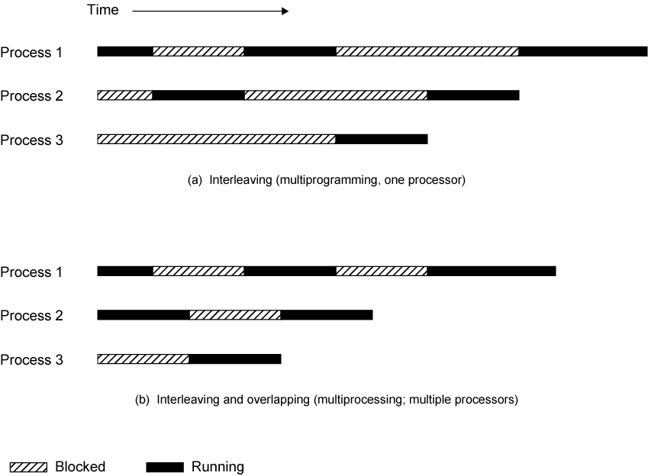
Multiprogramming and Multiprocessing

Slide 18
SMP Advantages
Performance
If some work can be done in parallel
Availability
Since all processors can perform the same functions, failure of a single processor does not halt the system
Incremental growth
User can enhance performance by adding additional processors
Scaling
Vendors can offer range of products based on number of processors

Slide 19
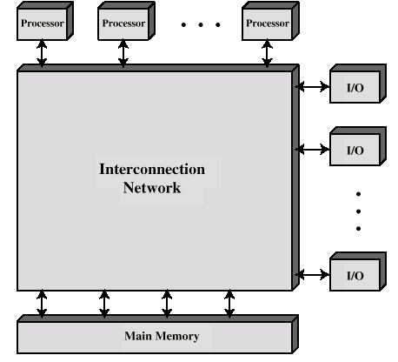
Block Diagram of Tightly Coupled Multiprocessor

Slide 20
Organization Classification
Time shared or common bus
Multiport memory
Central control unit

Slide 21
Time Shared Bus
Simplest form
Structure and interface similar to single processor system
Following features provided
Addressing - distinguish modules on bus
Arbitration - any module can be temporary master
Time sharing - if one module has the bus, others must wait and may have to suspend
Now have multiple processors as well as multiple I/O modules

Slide 22
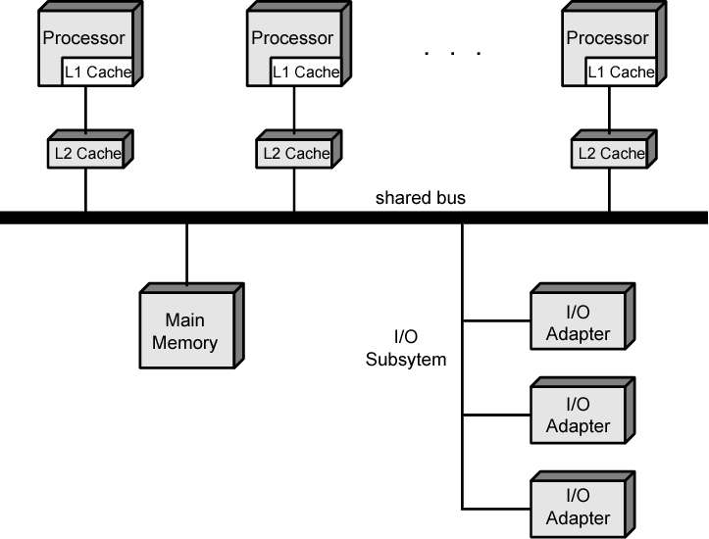
Symmetric Multiprocessor Organization

Slide 23
Time Share Bus - Advantages
Simplicity
Flexibility
Reliability

Slide 24
Time Share Bus - Disadvantage
Performance limited by bus cycle time
Each processor should have local cache
Reduce number of bus accesses
Leads to problems with cache coherence
Solved in hardware - see later

Slide 25
Operating System Issues
Simultaneous concurrent processes
Scheduling
Synchronization
Memory management
Reliability and fault tolerance

Slide 26
A Mainframe SMP IBM zSeries
Uniprocessor with one main memory card to a high-end system with 48 processors and 8 memory cards
Dual-core processor chip
Each includes two identical central processors (CPs)
CISC superscalar microprocessor
Mostly hardwired, some vertical microcode
256-kB L1 instruction cache and a 256-kB L1 data cache
L2 cache 32 MB
Clusters of five
Each cluster supports eight processors and access to entire main memory space
System control element (SCE)
Arbitrates system communication
Maintains cache coherence
Main store control (MSC)
Interconnect L2 caches and main memory
Memory card
Each 32 GB, Maximum 8 , total of 256 GB
Interconnect to MSC via synchronous memory interfaces (SMIs)
Memory bus adapter (MBA)
Interface to I/O channels, go directly to L2 cache

Slide 27
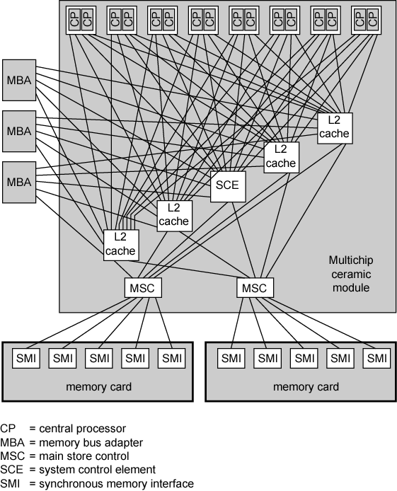
IBM z990 Multiprocessor Structure

Slide 28
Cache Coherence and MESI Protocol
Problem - multiple copies of same data in different caches
Can result in an inconsistent view of memory
Write back policy can lead to inconsistency
Write through can also give problems unless caches monitor memory traffic

Slide 29
Software Solutions
Compiler and operating system deal with problem
Overhead transferred to compile time
Design complexity transferred from hardware to software
However, software tends to make conservative decisions
Inefficient cache utilization
Analyze code to determine safe periods for caching shared variables

Slide 30
Hardware Solution
Cache coherence protocols
Dynamic recognition of potential problems
Run time
More efficient use of cache
Transparent to programmer
Directory protocols
Snoopy protocols

Slide 31
Directory Protocols
Collect and maintain information about copies of data in cache
Directory stored in main memory
Requests are checked against directory
Appropriate transfers are performed
Creates central bottleneck
Effective in large scale systems with complex interconnection schemes

Slide 32
Snoopy Protocols
Distribute cache coherence responsibility among cache controllers
Cache recognizes that a line is shared
Updates announced to other caches
Suited to bus based multiprocessor
Increases bus traffic

Slide 33
Write Invalidate
Multiple readers, one writer
When a write is required, all other caches of the line are invalidated
Writing processor then has exclusive (cheap) access until line required by another processor
Used in Pentium II and PowerPC systems
State of every line is marked as modified, exclusive, shared or invalid
MESI

Slide 34
Write Update
Multiple readers and writers
Updated word is distributed to all other processors
Some systems use an adaptive mixture of both solutions

Slide 35
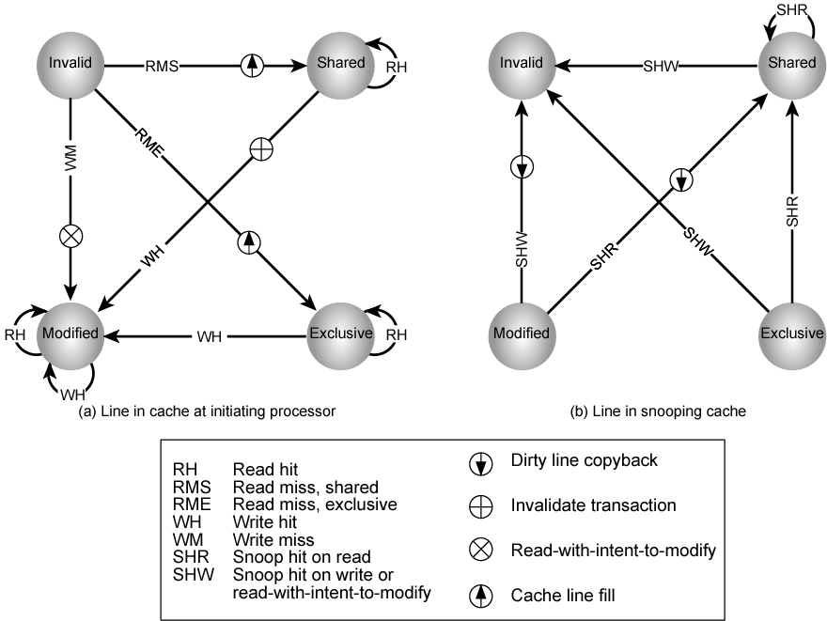
MESI State Transition Diagram

Slide 36
Increasing Performance
Processor performance can be measured by the rate at which it executes instructions
MIPS rate = f * IPC
f processor clock frequency, in MHz
IPC is average instructions per cycle
Increase performance by increasing clock frequency and increasing instructions that complete during cycle
May be reaching limit
Complexity
Power consumption

Slide 37
Multithreading and Chip Multiprocessors
Instruction stream divided into smaller streams (threads)
Executed in parallel
Wide variety of multithreading designs

Slide 38
Definitions of Threads and Processes
Thread in multithreaded processors may or may not be same as software threads
Process:
An instance of program running on computer
Resource ownership
Virtual address space to hold process image
Scheduling/execution
Process switch
Thread: dispatchable unit of work within process
Includes processor context (which includes the program counter and stack pointer) and data area for stack
Thread executes sequentially
Interruptible: processor can turn to another thread
Thread switch
Switching processor between threads within same process
Typically less costly than process switch

Slide 39
Implicit and Explicit Multithreading
All commercial processors and most experimental ones use explicit multithreading
Concurrently execute instructions from different explicit threads
Interleave instructions from different threads on shared pipelines or parallel execution on parallel pipelines
Implicit multithreading is concurrent execution of multiple threads extracted from single sequential program
Implicit threads defined statically by compiler or dynamically by hardware

Slide 40
Approaches to Explicit Multithreading
Interleaved
Fine-grained
Processor deals with two or more thread contexts at a time
Switching thread at each clock cycle
If thread is blocked it is skipped
Blocked
Coarse-grained
Thread executed until event causes delay
E.g.Cache miss
Effective on in-order processor
Avoids pipeline stall
Simultaneous (SMT)
Instructions simultaneously issued from multiple threads to execution units of superscalar processor
Chip multiprocessing
Processor is replicated on a single chip
Each processor handles separate threads

Slide 41
Scalar Processor Approaches
Single-threaded scalar
Simple pipeline
No multithreading
Interleaved multithreaded scalar
Easiest multithreading to implement
Switch threads at each clock cycle
Pipeline stages kept close to fully occupied
Hardware needs to switch thread context between cycles
Blocked multithreaded scalar
Thread executed until latency event occurs
Would stop pipeline
Processor switches to another thread

Slide 42
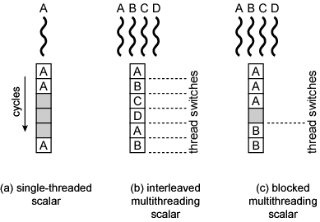
Scalar Diagrams

Slide 43
Multiple Instruction Issue Processors (1)
Superscalar
No multithreading
Interleaved multithreading superscalar:
Each cycle, as many instructions as possible issued from single thread
Delays due to thread switches eliminated
Number of instructions issued in cycle limited by dependencies
Blocked multithreaded superscalar
Instructions from one thread
Blocked multithreading used

Slide 44
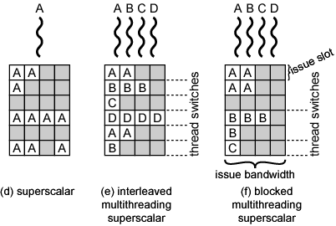
Multiple Instruction Issue Diagram (1)

Slide 45
Multiple Instruction Issue Processors (2)
Very long instruction word (VLIW)
E.g. IA-64
Multiple instructions in single word
Typically constructed by compiler
Operations that may be executed in parallel in same word
May pad with no-ops
Interleaved multithreading VLIW
Similar efficiencies to interleaved multithreading on superscalar architecture
Blocked multithreaded VLIW
Similar efficiencies to blocked multithreading on superscalar architecture

Slide 46
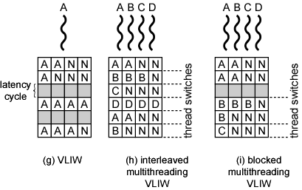
Multiple Instruction Issue Diagram (2)

Slide 47
Parallel, Simultaneous Execution of Multiple Threads
Simultaneous multithreading
Issue multiple instructions at a time
One thread may fill all horizontal slots
Instructions from two or more threads may be issued
With enough threads, can issue maximum number of instructions on each cycle
Chip multiprocessor
Multiple processors
Each has two-issue superscalar processor
Each processor is assigned thread
Can issue up to two instructions per cycle per thread

Slide 48
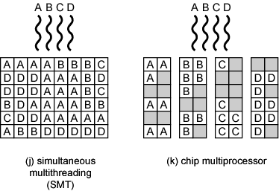
Parallel Diagram

Slide 49
Examples
Some Pentium 4
Intel calls it hyperthreading
SMT with support for two threads
Single multithreaded processor, logically two processors
IBM Power5
High-end PowerPC
Combines chip multiprocessing with SMT
Chip has two separate processors
Each supporting two threads concurrently using SMT

Slide 50
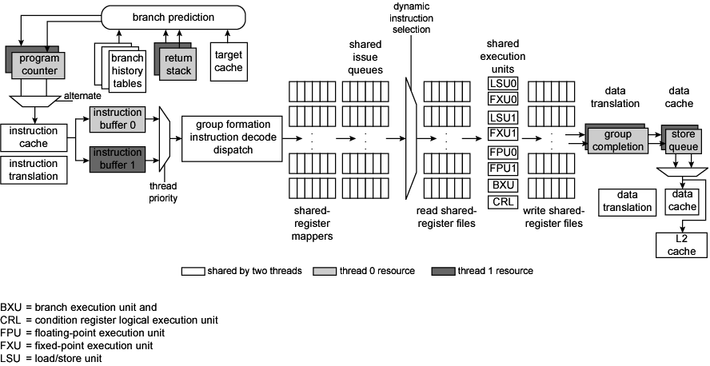
Power5 Instruction Data Flow

Slide 51
Clusters
Alternative to SMP
High performance
High availability
Server applications
A group of interconnected whole computers
Working together as unified resource
Illusion of being one machine
Each computer called a node

Slide 52
Cluster Benefits
Absolute scalability
Incremental scalability
High availability
Superior price/performance

Slide 53
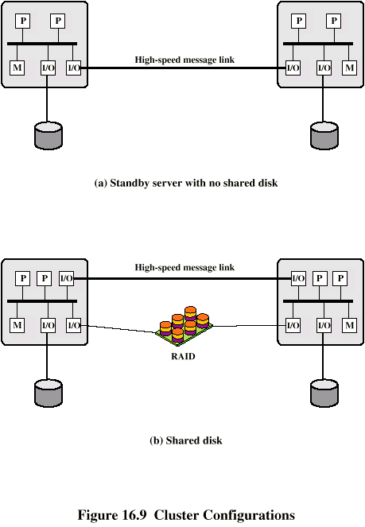
Cluster Configurations - Standby Server, No Shared Disk

Slide 54
Cluster Configurations - Shared Disk

Slide 55
Operating Systems Design Issues
Failure Management
High availability
Fault tolerant
Failover
Switching applications & data from failed system to alternative within cluster
Failback
Restoration of applications and data to original system
After problem is fixed
Load balancing
Incremental scalability
Automatically include new computers in scheduling
Middleware needs to recognise that processes may switch between machines

Slide 56
Parallelizing
Single application executing in parallel on a number of machines in cluster
Complier
Determines at compile time which parts can be executed in parallel
Split off for different computers
Application
Application written from scratch to be parallel
Message passing to move data between nodes
Hard to program
Best end result
Parametric computing
If a problem is repeated execution of algorithm on different sets of data
e.g. simulation using different scenarios
Needs effective tools to organize and run

Slide 57
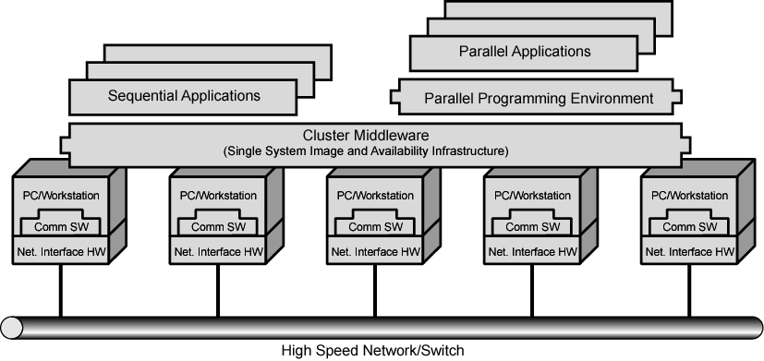
Cluster Computer Architecture

Slide 58
Cluster Middleware
Unified image to user
Single system image
Single point of entry
Single file hierarchy
Single control point
Single virtual networking
Single memory space
Single job management system
Single user interface
Single I/O space
Single process space
Checkpointing
Process migration

Slide 59
Blade Servers
Common implementation of cluster
Server houses multiple server modules (blades) in single chassis
Save space
Improve system management
Chassis provides power supply
Each blade has processor, memory, disk

Slide 60
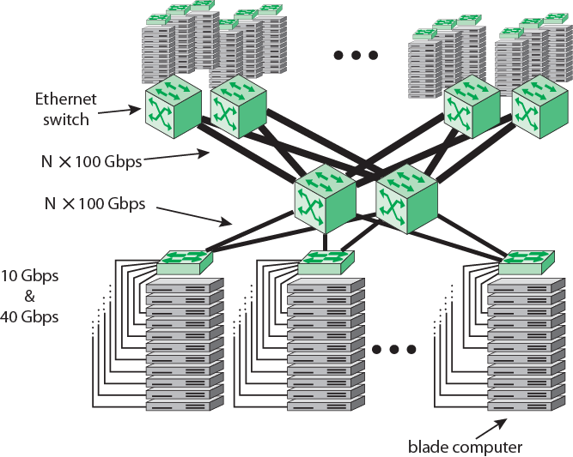
Example 100-Gbps Ethernet Configuration for Massive Blade Server Site

Slide 61
Cluster v. SMP
Both provide multiprocessor support to high demand applications.
Both available commercially
SMP for longer
SMP:
Easier to manage and control
Closer to single processor systems
Scheduling is main difference
Less physical space
Lower power consumption
Clustering:
Superior incremental & absolute scalability
Superior availability
Redundancy

Slide 62
Nonuniform Memory Access (NUMA)
Alternative to SMP & clustering
Uniform memory access
All processors have access to all parts of memory
Using load & store
Access time to all regions of memory is the same
Access time to memory for different processors same
As used by SMP
Nonuniform memory access
All processors have access to all parts of memory
Using load & store
Access time of processor differs depending on region of memory
Different processors access different regions of memory at different speeds
Cache coherent NUMA
Cache coherence is maintained among the caches of the various processors
Significantly different from SMP and clusters

Slide 63
Motivation
SMP has practical limit to number of processors
Bus traffic limits to between 16 and 64 processors
In clusters each node has own memory
Apps do not see large global memory
Coherence maintained by software not hardware
NUMA retains SMP flavour while giving large scale multiprocessing
e.g. Silicon Graphics Origin NUMA 1024 MIPS R10000 processors
Objective is to maintain transparent system wide memory while permitting multiprocessor nodes, each with own bus or internal interconnection system

Slide 64
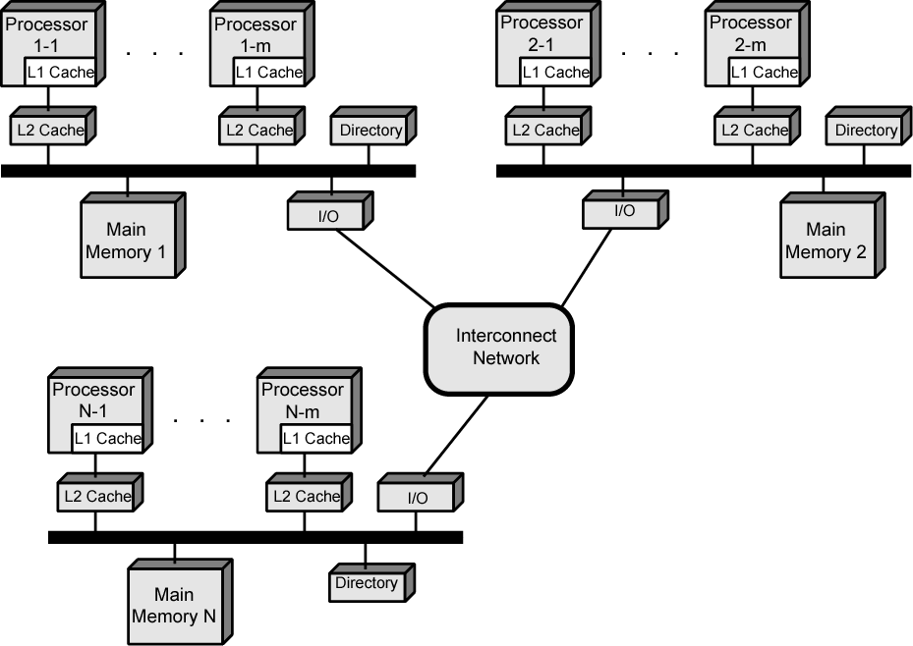
CC-NUMA Organization

Slide 65
CC-NUMA Operation
Each processor has own L1 and L2 cache
Each node has own main memory
Nodes connected by some networking facility
Each processor sees single addressable memory space
Memory request order:
L1 cache (local to processor)
L2 cache (local to processor)
Main memory (local to node)
Remote memory
Delivered to requesting (local to processor) cache
Automatic and transparent

Slide 66
Memory Access Sequence
Each node maintains directory of location of portions of memory and cache status
e.g. node 2 processor 3 (P2-3) requests location 798 which is in memory of node 1
P2-3 issues read request on snoopy bus of node 2
Directory on node 2 recognises location is on node 1
Node 2 directory requests node 1’s directory
Node 1 directory requests contents of 798
Node 1 memory puts data on (node 1 local) bus
Node 1 directory gets data from (node 1 local) bus
Data transferred to node 2’s directory
Node 2 directory puts data on (node 2 local) bus
Data picked up, put in P2-3’s cache and delivered to processor

Slide 67
Cache Coherence
Node 1 directory keeps note that node 2 has copy of data
If data modified in cache, this is broadcast to other nodes
Local directories monitor and purge local cache if necessary
Local directory monitors changes to local data in remote caches and marks memory invalid until writeback
Local directory forces writeback if memory location requested by another processor

Slide 68
NUMA Pros & Cons
Effective performance at higher levels of parallelism than SMP
No major software changes
Performance can breakdown if too much access to remote memory
Can be avoided by:
L1 & L2 cache design reducing all memory access
Need good temporal locality of software
Good spatial locality of software
Virtual memory management moving pages to nodes that are using them most
Not transparent
Page allocation, process allocation and load balancing changes needed
Availability?

Slide 69
Vector Computation
Maths problems involving physical processes present different difficulties for computation
Aerodynamics, seismology, meteorology
Continuous field simulation
High precision
Repeated floating point calculations on large arrays of numbers
Supercomputers handle these types of problem
Hundreds of millions of flops
$10-15 million
Optimised for calculation rather than multitasking and I/O
Limited market
Research, government agencies, meteorology
Array processor
Alternative to supercomputer
Configured as peripherals to mainframe & mini
Just run vector portion of problems

Slide 70
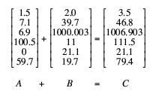
Vector Addition Example

Slide 71
Approaches
General purpose computers rely on iteration to do vector calculations
In example this needs six calculations
Vector processing
Assume possible to operate on one-dimensional vector of data
All elements in a particular row can be calculated in parallel
Parallel processing
Independent processors functioning in parallel
Use FORK N to start individual process at location N
JOIN N causes N independent processes to join and merge following JOIN
O/S Co-ordinates JOINs
Execution is blocked until all N processes have reached JOIN

Slide 72
Processor Designs
Pipelined ALU
Within operations
Across operations
Parallel ALUs
Parallel processors

Slide 73
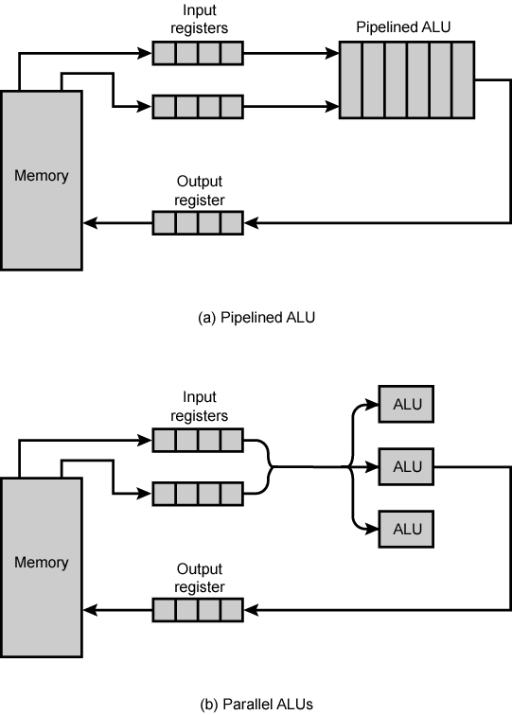
Approaches to Vector Computation

Slide 74
Chaining
Cray Supercomputers
Vector operation may start as soon as first element of operand vector available and functional unit is free
Result from one functional unit is fed immediately into another
If vector registers used, intermediate results do not have to be stored in memory

Slide 75
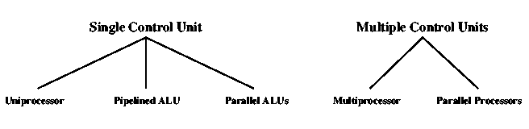
Computer Organizations

Slide 76
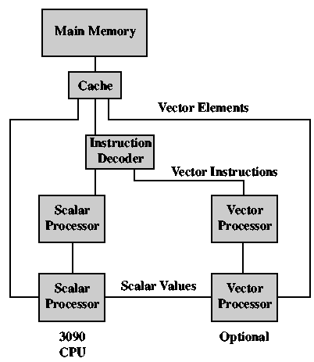
IBM 3090 with Vector Facility

Slide 77
References
William Stallings. Computer Organization and Architecture 8th Edition

